Slide 1


District Counselor Meeting
September 26, 2024

Slide 2



Here’s to a Fantastic School Year!

Slide 3

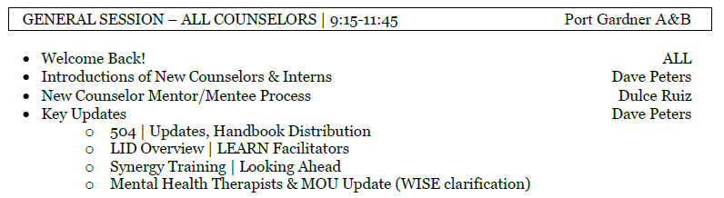
Today’s Agenda

Slide 4
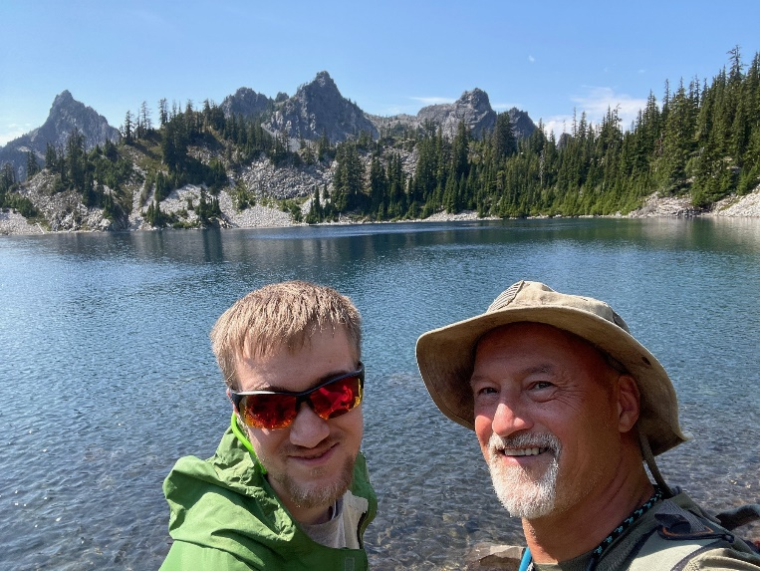
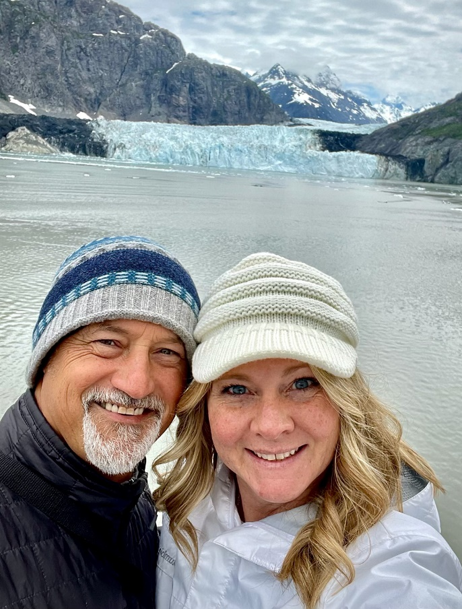

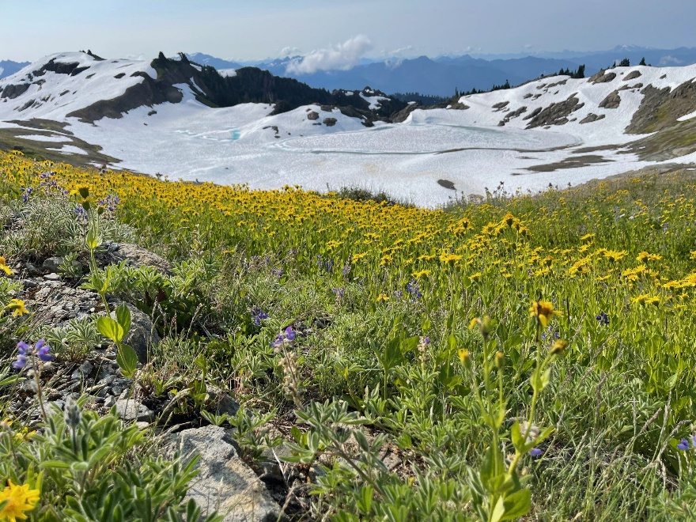
Memories of Summer

Slide 5
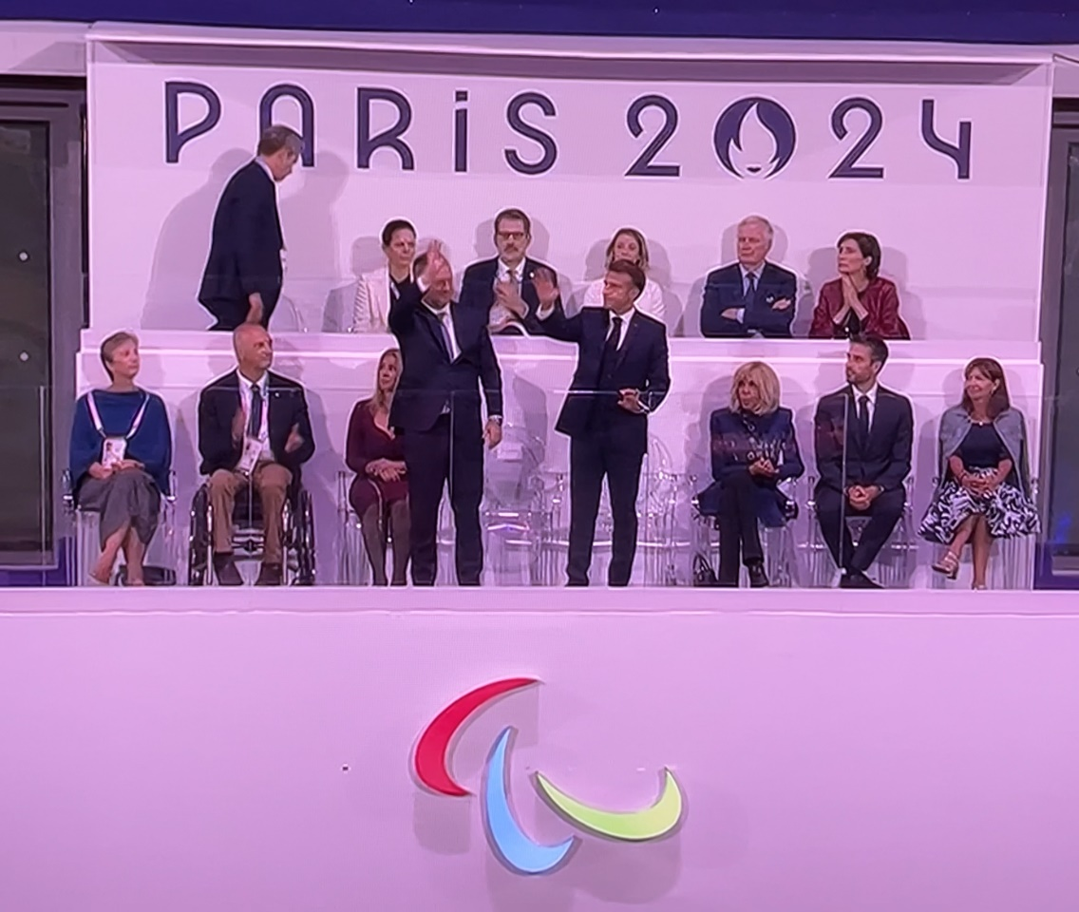
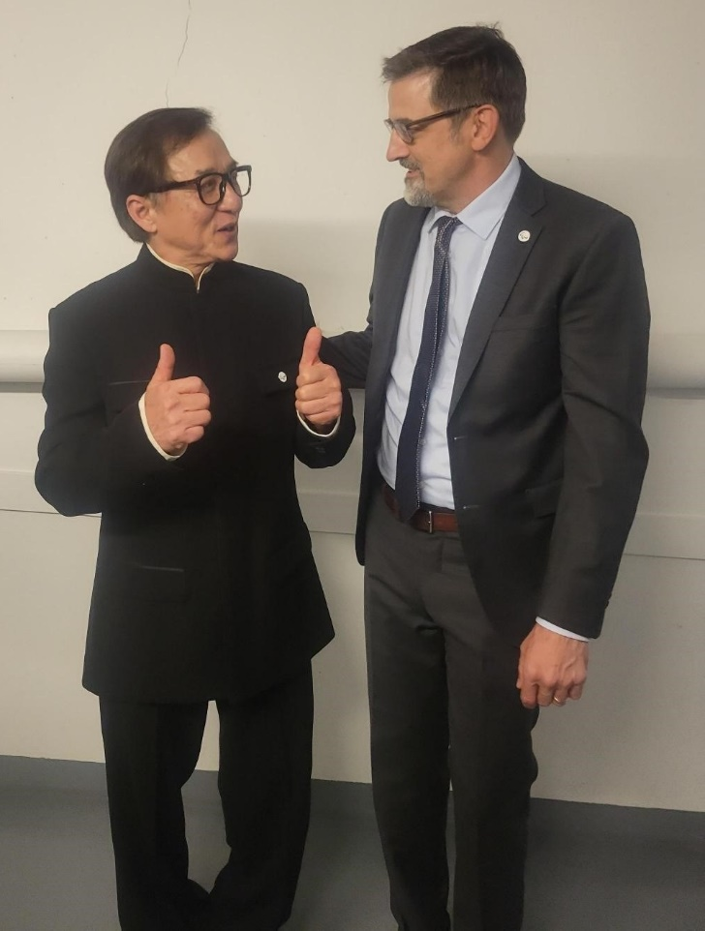
Memories of Summer
My brother, Mike
Emmanuel Macron, president of France
Jackie Chan

Slide 6

Our Newest Team Members

Slide 7
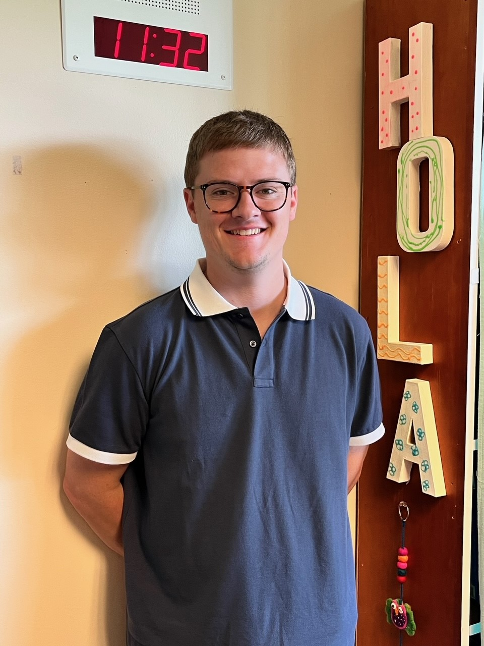
Our Newest Team Members
Michael Bernhisel
School
Emerson ES
Birthplace
Cody, Wyoming
Fun Fact
I lived in Mexico for 2 years.

Slide 8

Our Newest Team Members
Emily Dunham
School
Evergreen MS
Birthplace
Renton, Washington
Fun Fact
I’M GETTING MARRIED!!

Slide 9
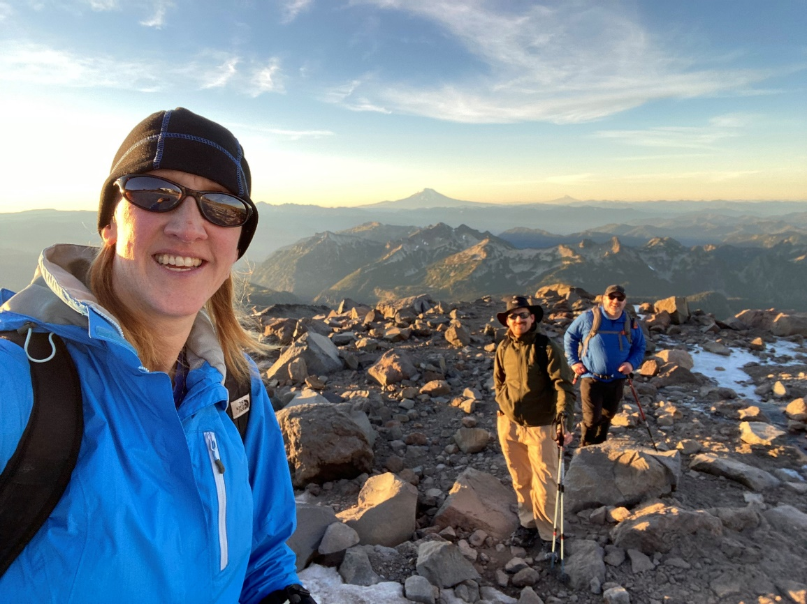
Our Newest Team Members
Julie Hills
School
Cascade HS
Birthplace
Seattle, Washington
Interests/Passions
Despite being hopelessly
uncoordinated for the first 25 or so years of life and playing no sports well, I picked up Ultimate Frisbee. My husband and I met playing frisbee, have raised our kids on the sidelines of our co-ed team for 12 years, I and have silver and bronze medals from national championship games with women’s Masters and Grand Masters teams. It’s never too late! 😊

Slide 10

Our Newest Team Members
Jenny Muscatell
School
Cedar Wood ES
Birthplace
Seattle, Washington
Interests/Passions
I love traveling, basketball,
Hello Kitty, pink, dogs, and
spending time with family.
Fun Fact
I attended all the way through K-12 in Everett Public Schools!

Slide 11
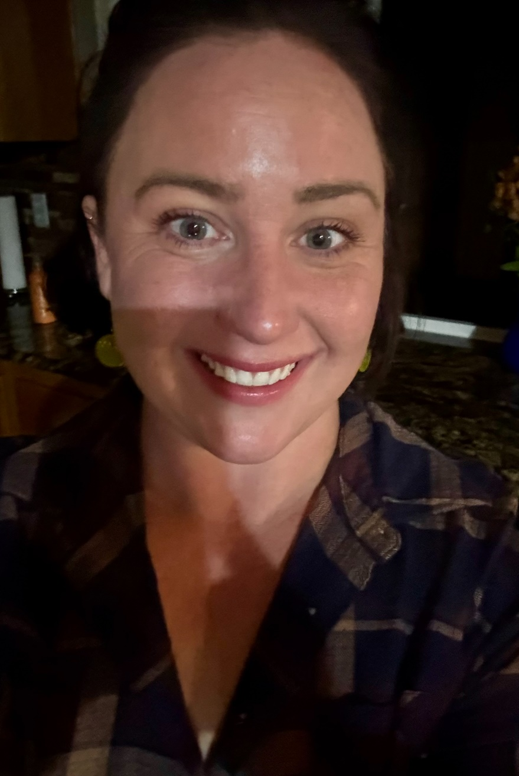
Our Newest Team Members
Katie Seaward
School
Silver Lake ES
Birthplace
Mount Vernon, Washington
Interests/Passions
My daughter and I try to take
historical ghost tours wherever we
go in throughout the states. We
have done them all the way from
Bend, Oregon to Key West, Florida.
We like it for the local history, the
stories, and the interesting people
we get to meet.

Slide 12
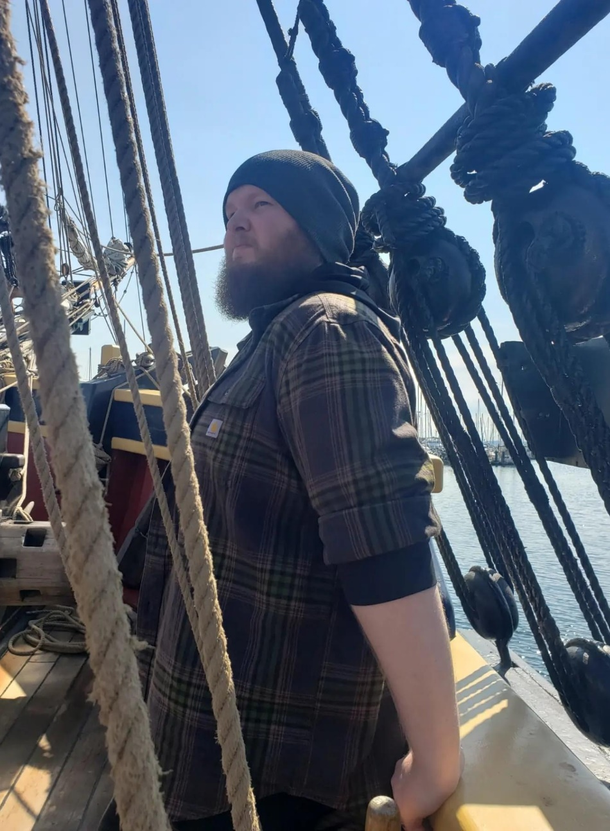
Our Newest Team Members
Colin Webb
School
Silver Lake ES
Birthplace
Bellevue, Washington
Fun Fact
My favorite TV shows are
Penny Dreadful and Black Sails

Slide 13

Welcome to Our Interns
Brian Lee
School
Jackson HS
Mentor
Leiann Gregg
Birthplace
Born in Seattle, raised in
Anacortes, moved to
Mill Creek in 2009
Interests/Passions
One interest of mine is my general interest in Japanese media. I love Anime, movies, and the culture at large. My dream vacation is to have a long stay in Japan!

Slide 14
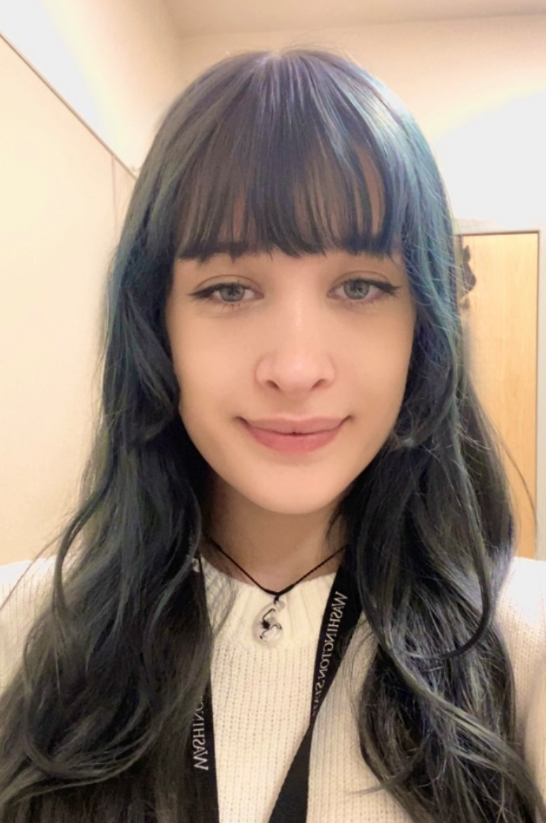
Welcome to Our Interns
Nadia Prater
School
North MS
Mentor
Jenny Steele
Birthplace
Riverside, California
Interests/Passions
I am very interested in video
games (especially, Minecraft,
The Sims, and FPS games).

Slide 15
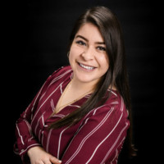
Mentors | New Counselors & Interns
All EPS interns must be approved by Human Resources prior to starting
Dulce Ruiz is the district coordinator
  druiz@everettsd.org / 425-385-4285
WEBSITE: Guide to Student Internships
PDF: Student Intern Placement Request Form
Dulce Ruiz
Diversifying Pathways Coordinator

Slide 16

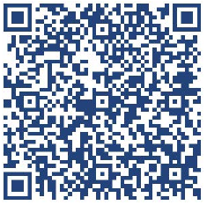
504 Handbook & Process Updates
Please discard previous copies of this handbook!
☺
Updated
504 Handbook for 2024-25

Slide 17
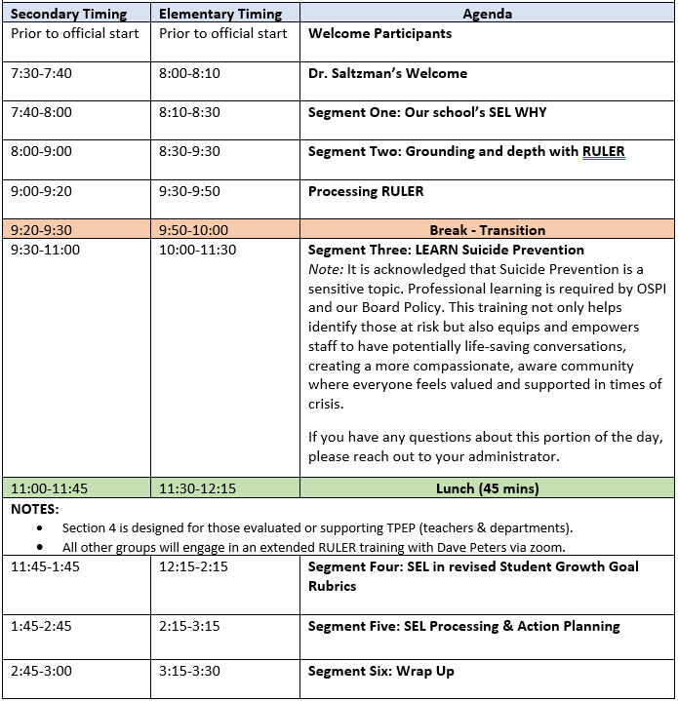
Oct. 11th LID Overview

Slide 18
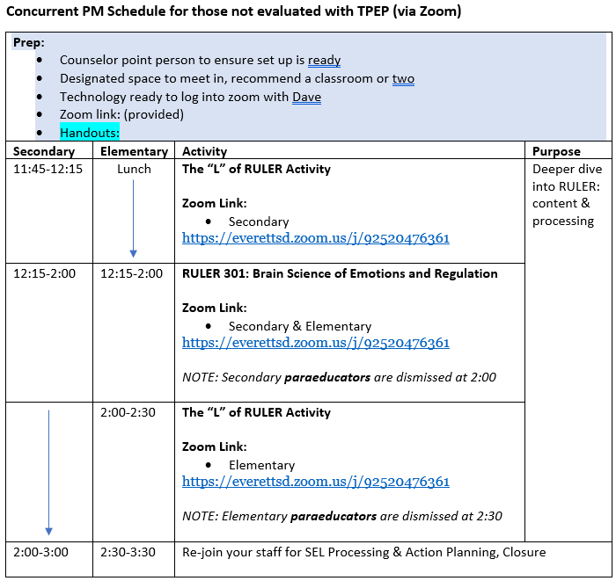
Oct. 11th LID Overview

Slide 19
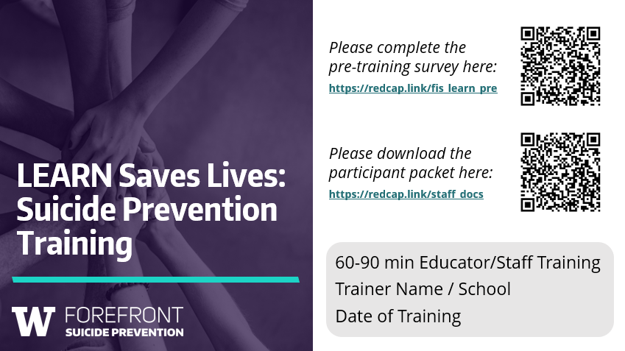
LID | Role of LEARN Facilitators

Slide 20

Look for warning signs
Emotions, Feelings
Actions, Behaviors
Experiences
Notes:
FACILITATOR NOTE
This is a 2-part slide. You will advance to the next slide before you are finished discussing this concept.
Short on time? Simply walk the audience through these warning signs without their participation.
Warning signs are clues or signals that someone may be at risk for suicide.
One way to think about warning signs is to think about them in 3 categories:
Emotions and feelings
Actions and behaviors
Experiences
ACTIVITY
Many people already have some idea of what they should keep an eye out for.
We would like to hear from you – what do you think are common warning signs for suicide?
[Wait for audience response]
Thank you for sharing!
We will look at additional warning signs on the next slide, many of which you already identified.
Keep in mind that…Not all warning signs are listed on these slides and, not all signs are a cause for concern by themselves.
We do want to be concerned when signs:
Are a change from someone’s usual personality
Have increased
Seem related to a painful event, loss, or change

Slide 21

Look for warning signs
Emotions, Feelings
Actions, Behaviors
Experiences
Notes:
FACILITATOR NOTE
This is a 2-part slide. You will advance to the next slide before you are finished discussing this concept.
Short on time? Simply walk the audience through these warning signs without their participation.
Warning signs are clues or signals that someone may be at risk for suicide.
One way to think about warning signs is to think about them in 3 categories:
Emotions and feelings
Actions and behaviors
Experiences
ACTIVITY
Many people already have some idea of what they should keep an eye out for.
We would like to hear from you – what do you think are common warning signs for suicide?
[Wait for audience response]
Thank you for sharing!
We will look at additional warning signs on the next slide, many of which you already identified.
Keep in mind that…Not all warning signs are listed on these slides and, not all signs are a cause for concern by themselves.
We do want to be concerned when signs:
Are a change from someone’s usual personality
Have increased
Seem related to a painful event, loss, or change

Slide 22






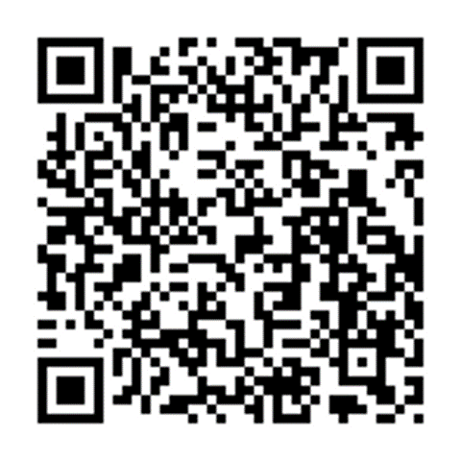
Practicing the LEARN steps
Meet Alex
Alex is withdrawing and isolating from friends (and family);
including increased absences at school.
Alex is struggling with the increased demands of school and a
part-time job and is easily overwhelmed lately.
(Alex also has easy access to large quantities of medication.)
Partner up & choose roles
Practice the LEARN steps
Change roles after 4 minutes
LEARN
Notes:
FACILITATOR NOTE
Virtual trainings will use breakout rooms! Assign participants into groups of 2. 3 is also OK.
Allow 8 minutes for this activity. We recommend more time if you are able.
Running short on time? At minimum, practice the A step.
Remind participants to switch roles after 4 minutes.
The scenario is also available here: https://redcap.link/comm_learn_scenario.
Now it is time for you to practice putting together the LEARN steps in a practice scenario. You’ll be in small groups of 2-3 for this activity. We know it is tempting to want to discuss the activity rather than practice it, but we highly encourage you to go through these steps at least once today.
We will be using Alex’s story to shape our LEARN conversation. Some of Alex’s warning signs are visible at school, some (in parentheses) are not.
In your groups:
One person will support Alex. (this person will be asking the question about suicide)
The other person will be playing Alex. For this activity, say “YES” during the A-step.
Practice having the LEARN conversation through at least the A-step.
Bonus points for R and N steps that include a warm handoff!
After a few minutes, I will ask you to switch roles.
The more you practice asking “are you thinking about suicide?” the more confident you will be if and when you need to use that phrase with a student or someone in your personal life.

Slide 23
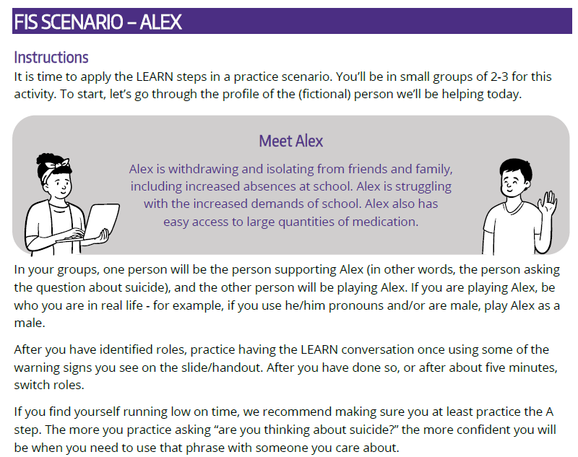
LID | Role of LEARN Facilitators
Participant Packet

Slide 24
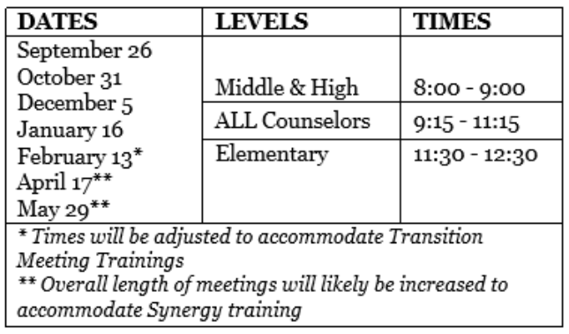
Synergy Training
ALL-COUNSELOR MEETINGS EXPANDED FOR SYNERGY TRAINING
April 17 & May 29, 2025
MS & HS | 8:00-9:00
All Counselors | 9:15-12:45
ES | 1:00-2:00

Slide 25
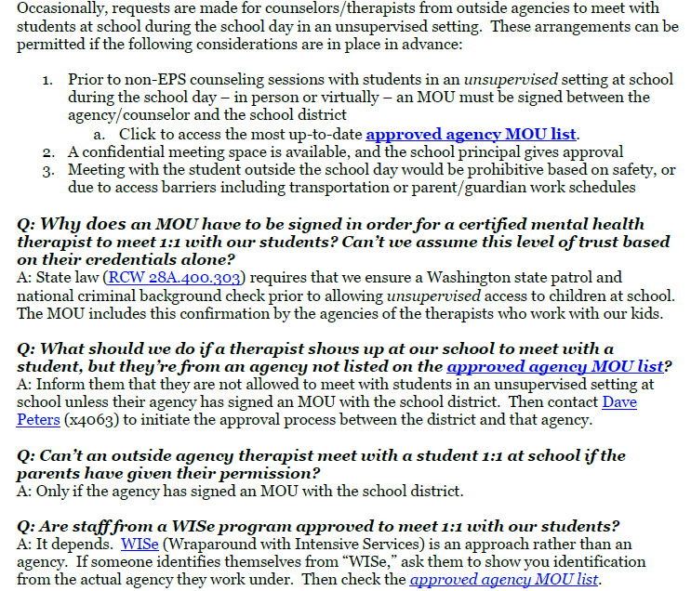
Mental Health Therapists in Schools

Slide 26
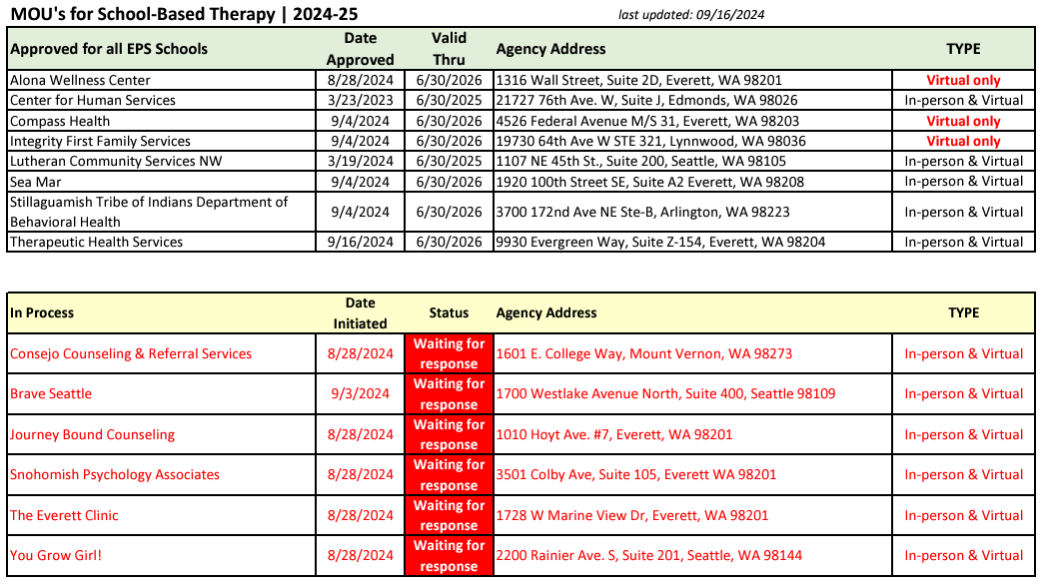
Mental Health Therapists in Schools

Slide 27


Here’s to a terrific year!

